Slide 1
Confirmation in 5th Class/P7

Slide 2
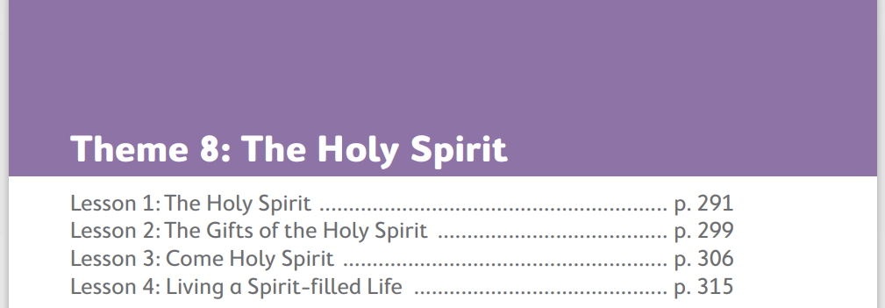

Slide 3
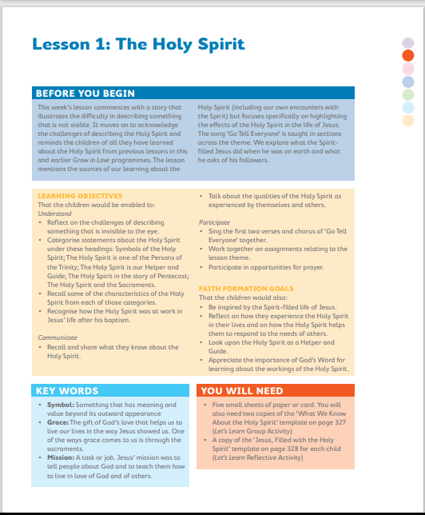
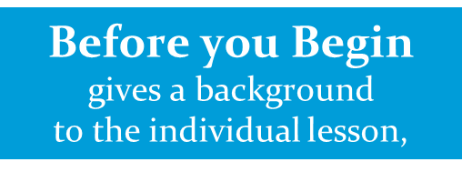
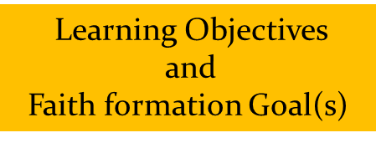
Lesson 1: The Holy Spirit

Slide 5
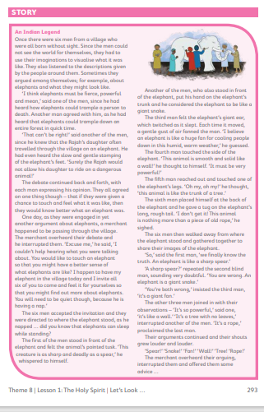

Slide 6
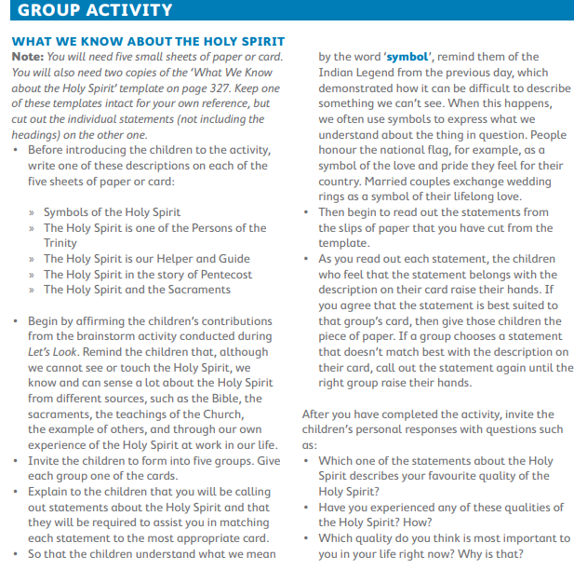

Slide 10
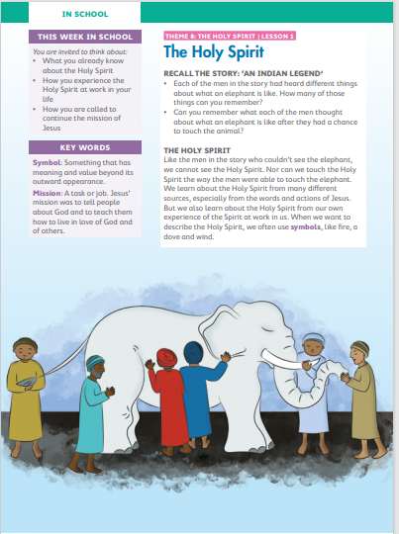
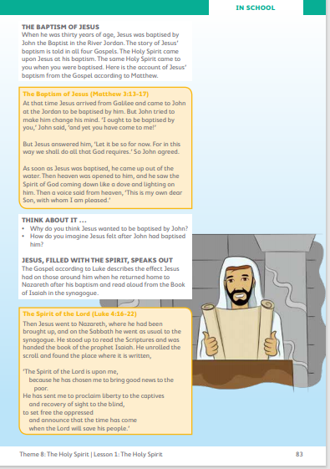
Pupil Book

Slide 11
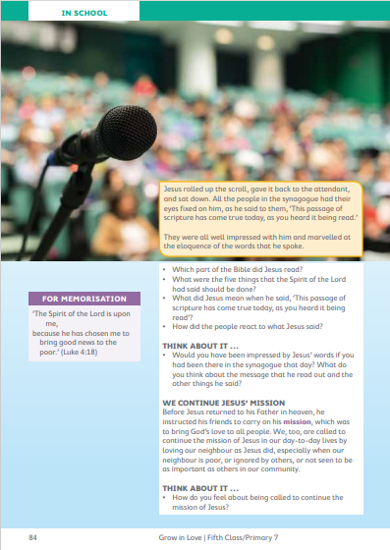
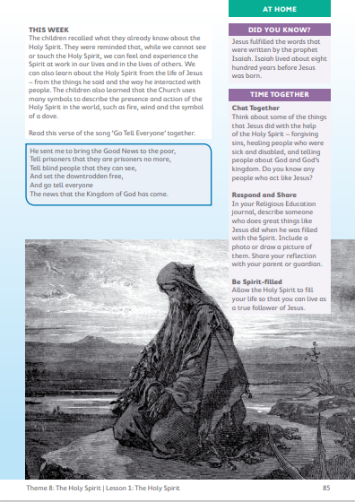
Pupil Book

Slide 12
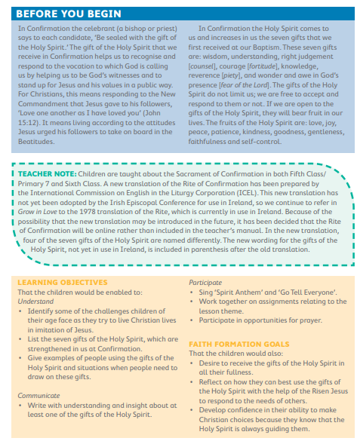
Lesson 2: The Gifts of the Holy Spirit

Slide 14
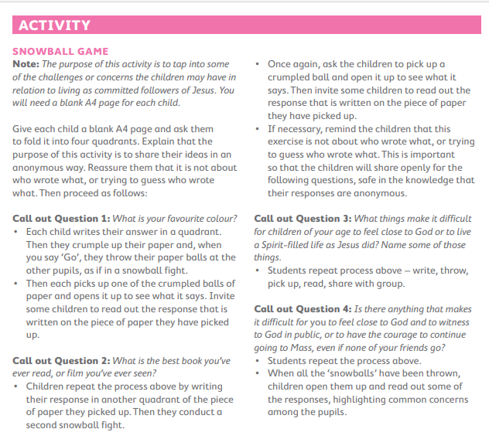

Slide 16
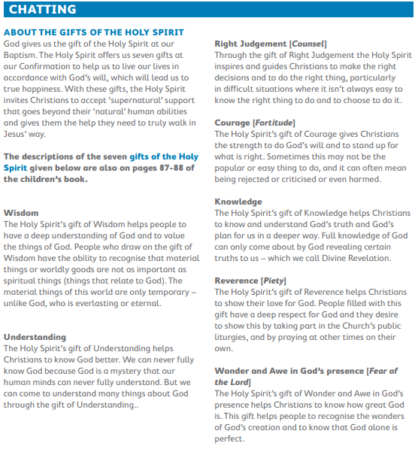

Slide 17
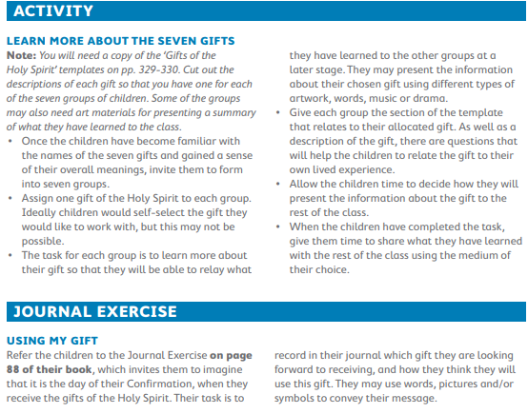

Slide 18
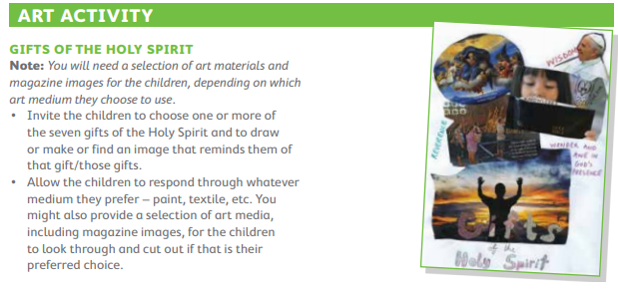
Prayer
Holy Spirit, bless me with
Knowledge to know right from wrong;
Courage to stand up and be strong;
Understanding to follow God’s way;
Reverence to worship and pray;
Right judgement to enlighten and guide me; Wisdom to want your presence beside me; Wonder and Awe to fill me with praise for God and God’s creation. Amen.

Slide 19
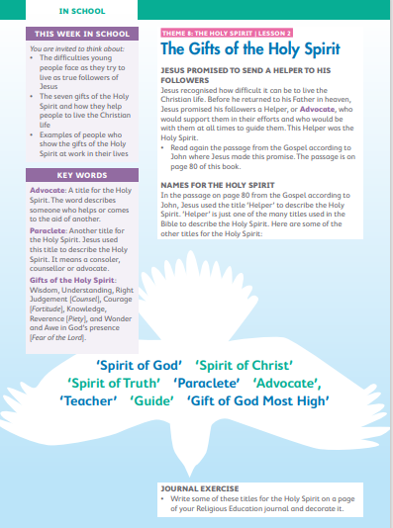
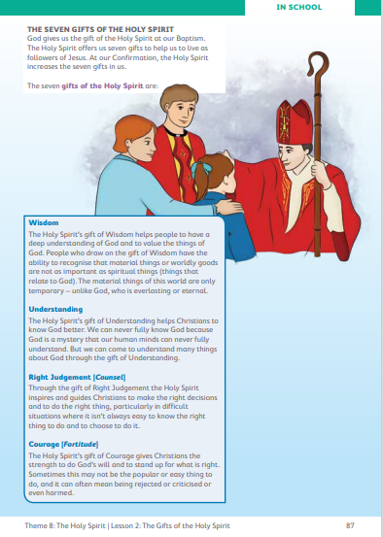
Pupil Book

Slide 20
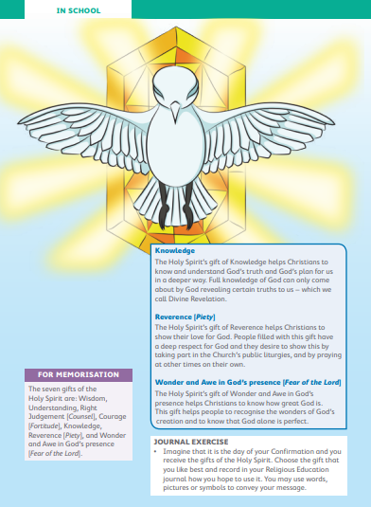
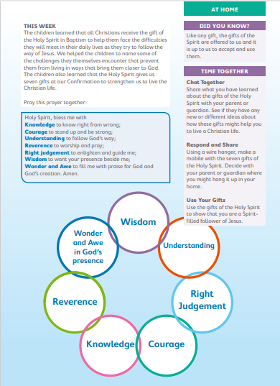
Pupil Book

Slide 21
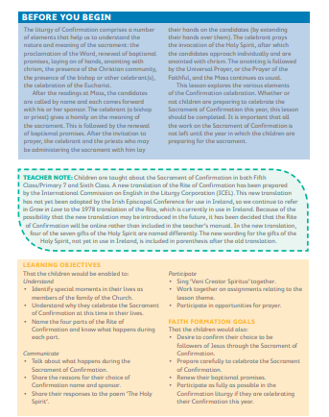
Lesson 3: Come Holy Spirit

Slide 22
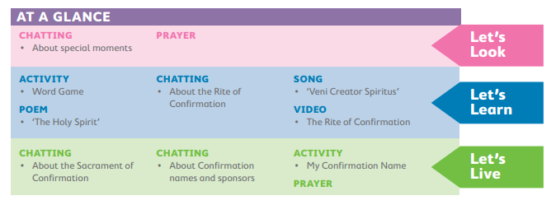

Slide 23
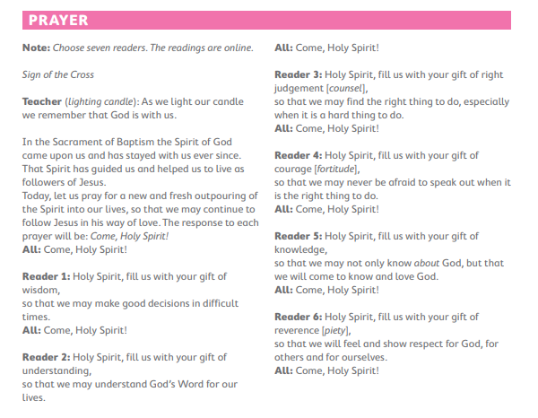
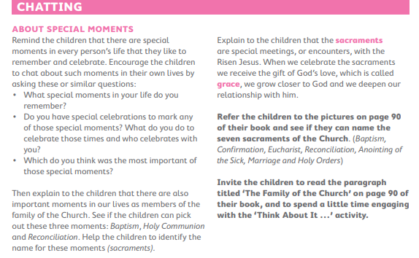

Slide 24
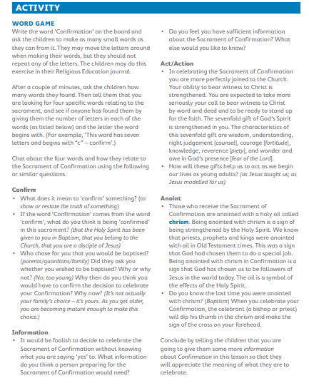
Poem-The Holy Spirit
As glass is soft and molten in the flame and moulded by the craftsman’s loving hand; as trees can blow and dance before the wind to music piped from where the rushes stand; as breath gives life and power to the arm to pull the oar and raise the haycock high; the dove of peace is shielding us from harm; he hovers in the hearts of you and I. His fire can warm and mould me tall and strong. His wind blows through my prayer, praise and song. His Breath fills me with life so I can be a sign of love and peace for all to see.
Christy Kenneally

Slide 25
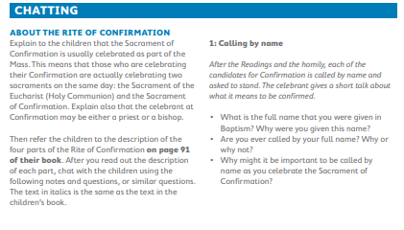

Slide 26
Song- ‘Veni Creator Spiritus’
Video- The Rite of Confirmation

Slide 27
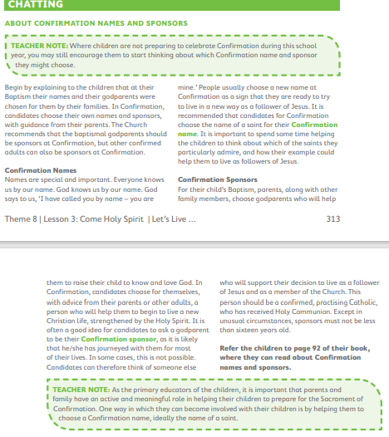
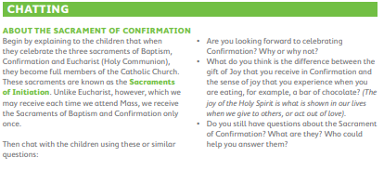

Slide 29
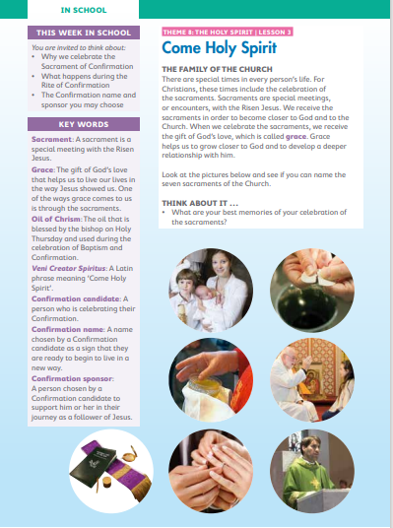
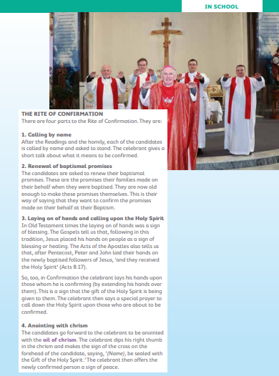

Slide 30
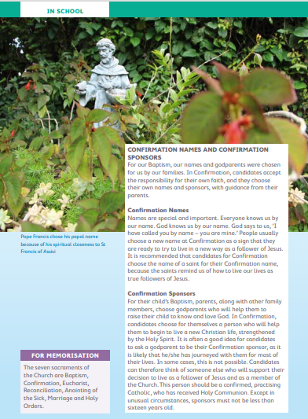
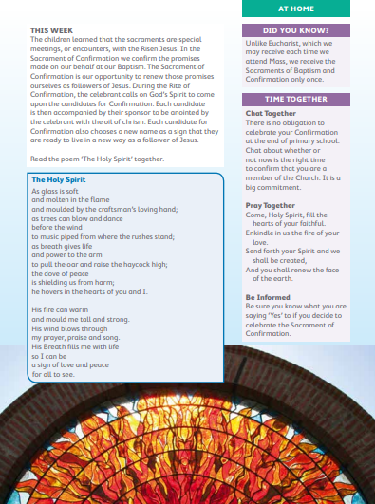

Slide 31
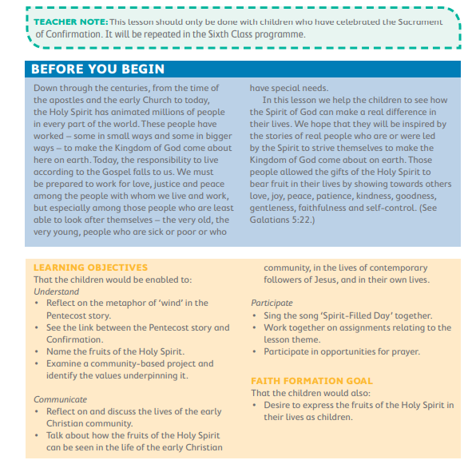
Lesson 4: Living a Spirit-filled Life

Slide 33
Vidoe-Foróige Croghan Citizenship Project

Slide 34
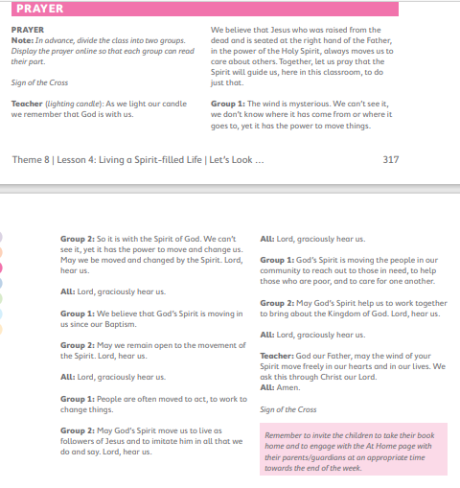

Slide 36
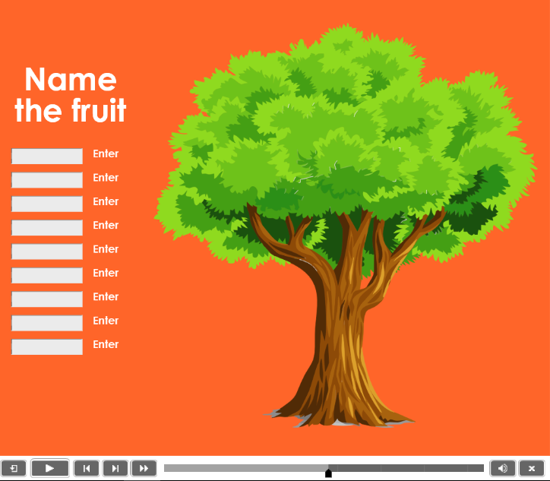
Interactive Activity

Slide 37
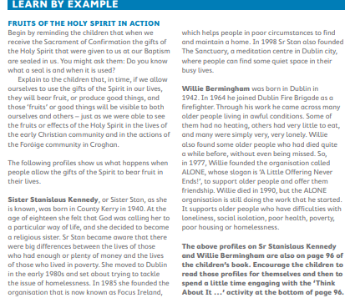
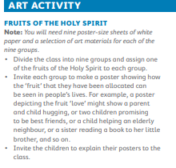

Slide 39
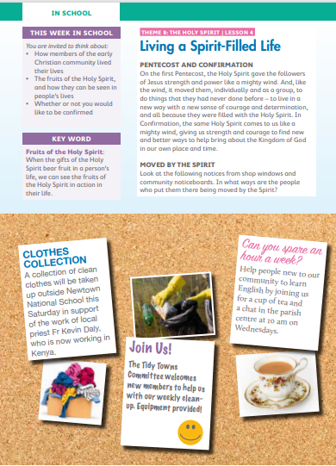
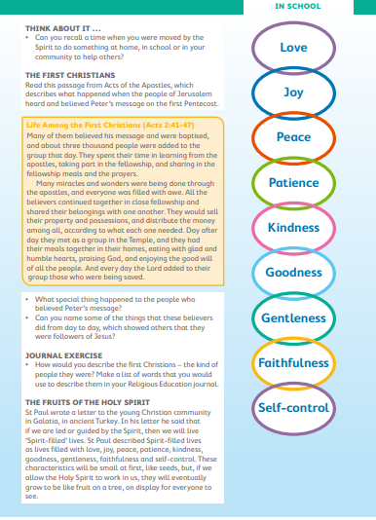

Slide 40
