Slide 1
First Reconciliation & First Communion Preparation

Slide 3
Lesson 1: Choices
Before you Begin
gives a background
to the individual lesson,
Learning Objectives
and
Faith formation Goal(s)

Slide 4
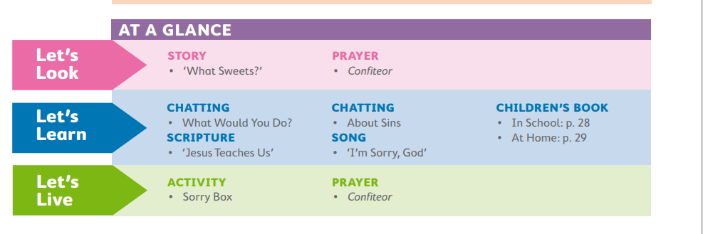
Lesson 1: Choices

Slide 5
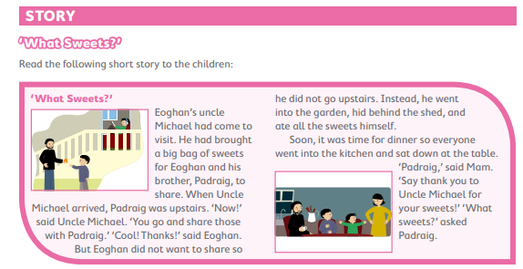
Lesson 1: Choices
Prayer- Confiteor
I confess to almighty God and to you, my brothers and sisters, that I have greatly sinned.

Slide 6
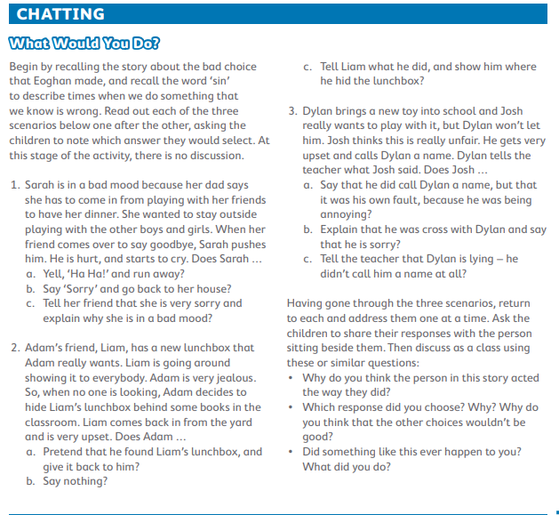
Lesson 1: Choices

Slide 7
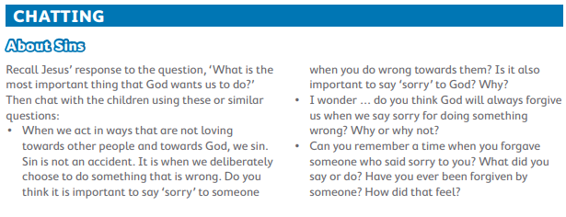

Slide 8
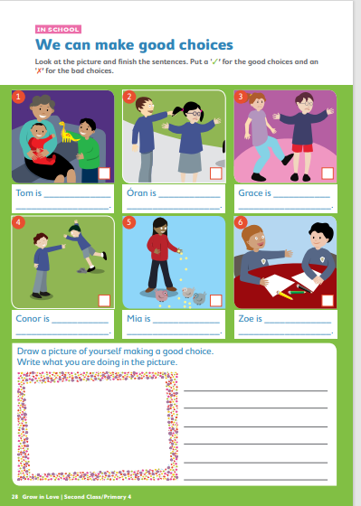
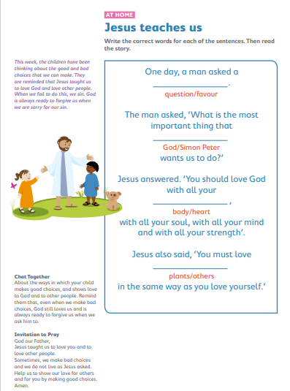
Lesson 1: Choices

Slide 9
Lesson 1: Choices
Prayer- Confiteor
I confess to almighty God and to you, my brothers and sisters, that I have greatly sinned. In my thoughts and in my words in what I have done and in what I have failed to do.

Slide 10
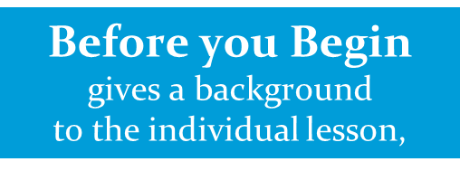
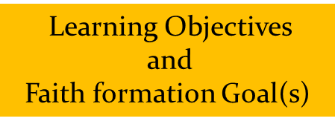
2: Zacchaeus made bad choices

Slide 11
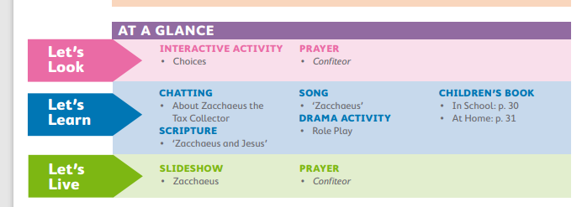
2: Zacchaeus made bad choices

Slide 12
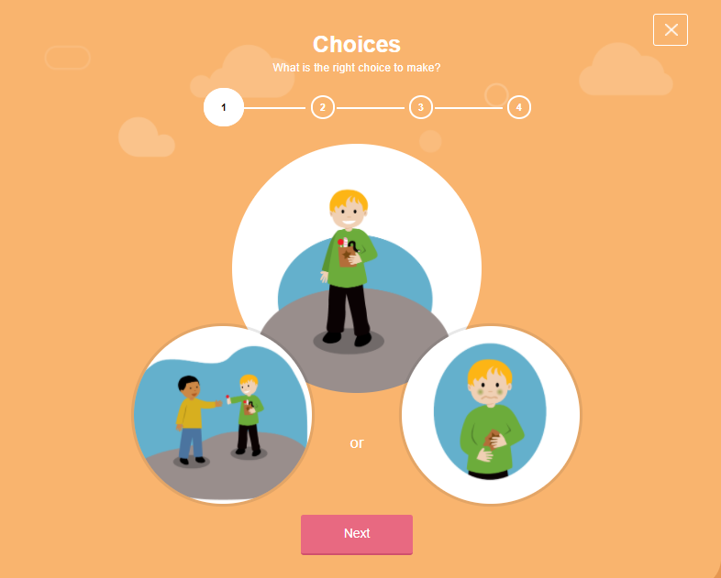
2: Zacchaeus made bad choices
Prayer- Confiteor
I confess to almighty God and to you, my brothers and sisters, that I have greatly sinned In my thoughts and in my words in what I have done and in what I have failed to do.

Slide 13
2: Zacchaeus made bad choices

Slide 14
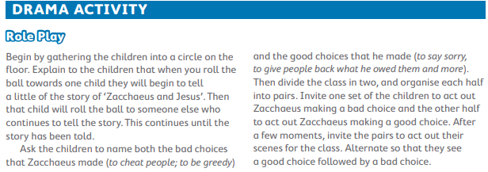
Song- Zacchaeus

Slide 15
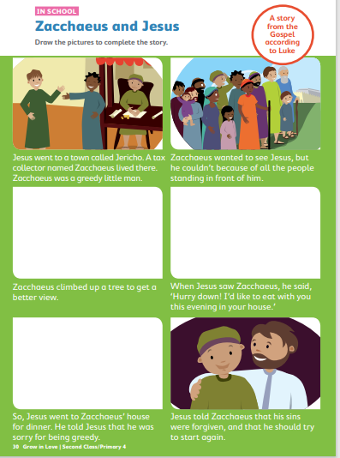
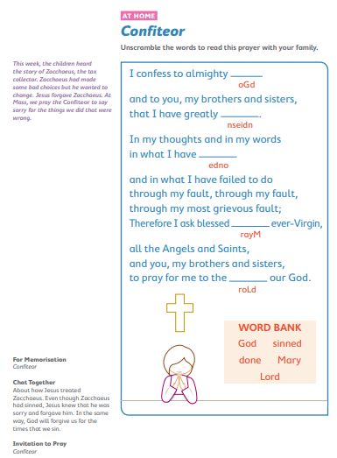

Slide 16
2: Zacchaeus made bad choices
Prayer- Confiteor
I confess to almighty God and to you, my brothers and sisters, that I have greatly sinned In my thoughts and in my words in what I have done and in what I have failed to do through my fault, through my fault, through my most grievous fault;

Slide 17
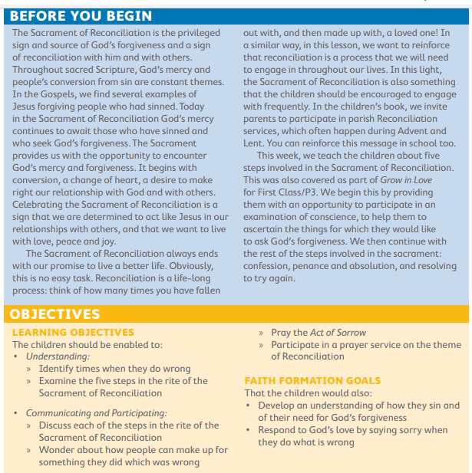
3: We can be forgiven

Slide 18
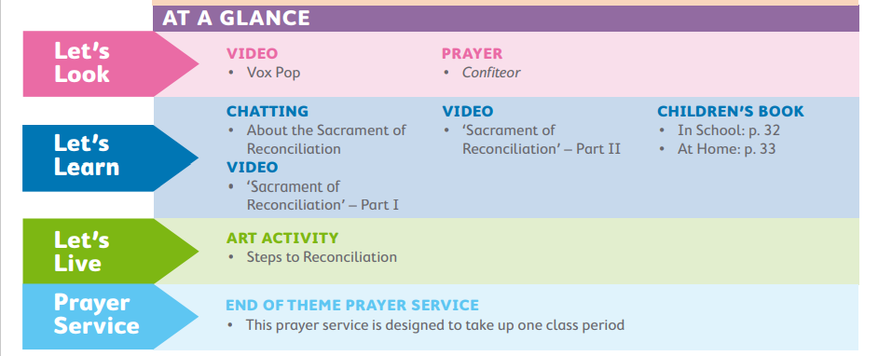
3: We can be forgiven

Slide 19
Prayer- Confiteor
I confess to almighty God and to you, my brothers and sisters, that I have greatly sinned In my thoughts and in my words in what I have done and in what I have failed to do through my fault, through my fault, through my most grievous fault; Therefore I ask blessed Mary ever-Virgin, all the Angels and Saints, and you, my brothers and sisters, to pray for me to the Lord our God.

Slide 22
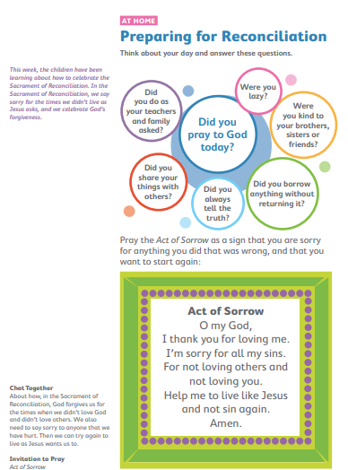

Slide 24
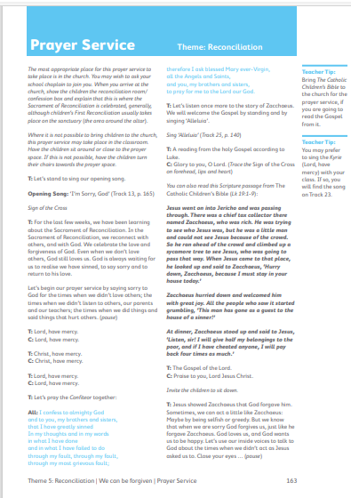
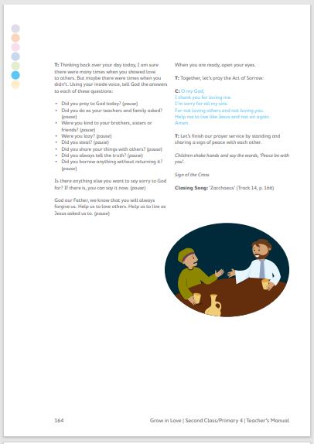

Slide 26
1: ‘Do this in memory of me’

Slide 27
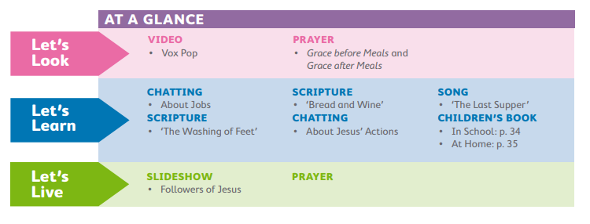
1: ‘Do this in memory of me’

Slide 28
1: ‘Do this in memory of me’
Grace before Meals
Bless us, O God, as we sit together. Bless the food we eat today. Bless the hands that made the food. Bless us, O God. Amen.
Grace after Meals
Thank you, God, for the food we have eaten. Thank you, God, for all our friends. Thank you, God, for everything. Thank you, God. Amen.

Slide 29
1: ‘Do this in memory of me’

Slide 30
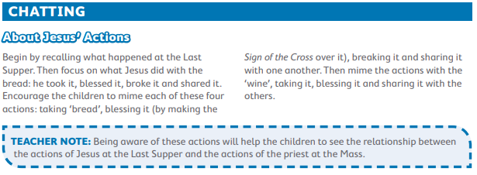
1: ‘Do this in memory of me’
Song- The Last Supper

Slide 31
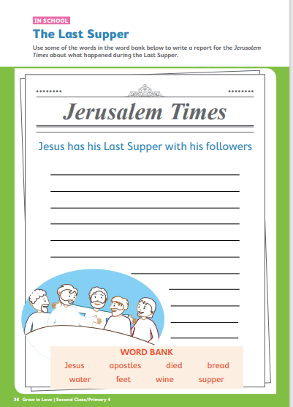
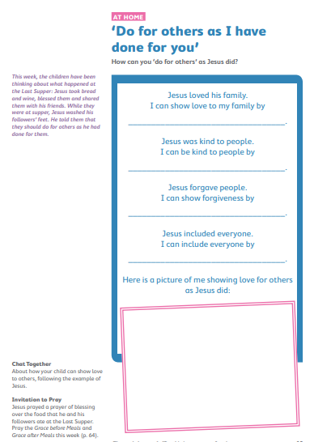
1: ‘Do this in memory of me’
Pupil book

Slide 32
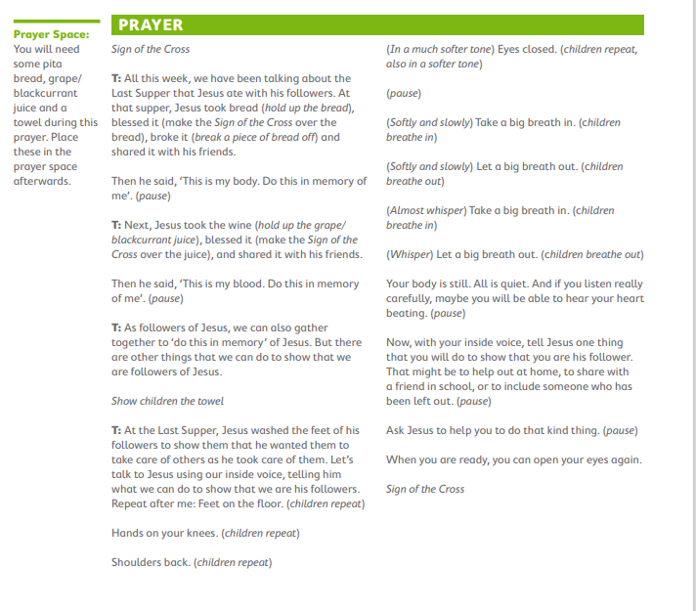

Slide 33
2: At Mass, we thank God

Slide 35
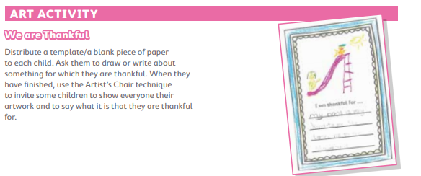
Poem
I Am Thankful
I am thankful for my cat, He keeps away the yucky rats. I am thankful for my mother, She loves me and my little brother. I am thankful for my toys, Especially the ones that make lots of noise. I am thankful for my swing, I can play on it in spring. I am thankful for chocolate treats, Or any kind of yummy sweets. What about you? What can you name? Are you thankful for the same?

Slide 36
Prayer before Communion
Lord Jesus, come to me, Lord Jesus, give me your love, Lord Jesus, come to me and give me yourself. Lord Jesus, friend of children, come to me. Lord Jesus, you are my Lord and my God. Praise to you, Lord Jesus Christ.
Song- Eat this bread

Slide 37
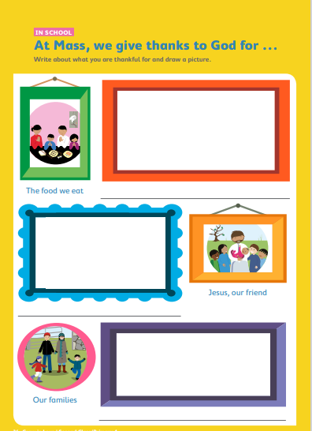
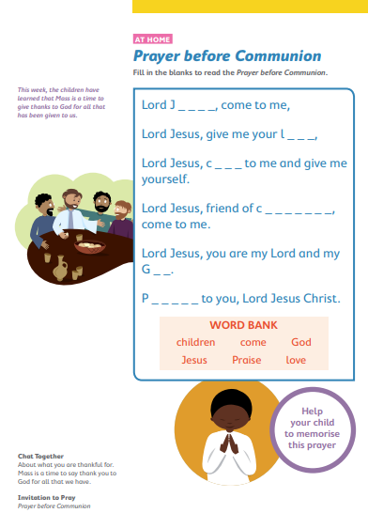

Slide 39
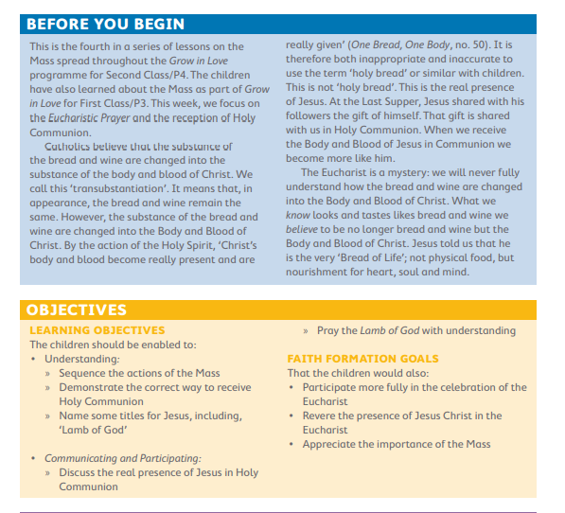
3: At Mass, we receive Holy Communion

Slide 40
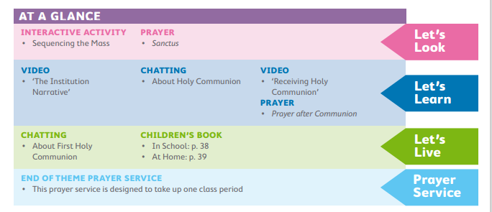

Slide 41
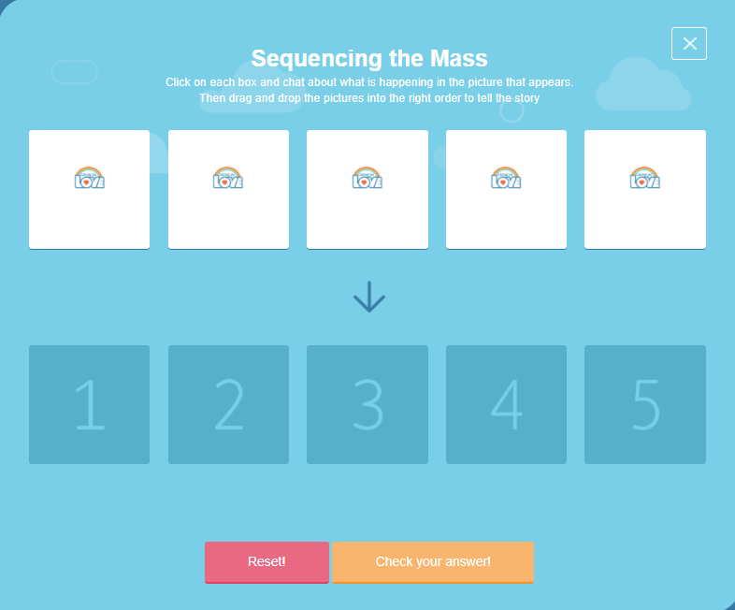
3: At Mass, we receive Holy Communion
Prayer-Sanctus
Holy, holy, holy Lord, God of hosts, Heaven and earth are full of your glory. Hosanna in the highest. Blessed is he who comes in the name of the Lord. Hosanna in the highest.

Slide 42
Prayer after Communion
Lord Jesus, I love and adore you. You’re a special friend to me. Welcome, Lord Jesus, O welcome, thank you for coming to me. Thank you, Lord Jesus, O thank you For giving yourself to me. Make me strong to show your love Wherever I may be. Be near me, Lord Jesus, I ask you to stay Close by me forever and love me, I pray. Bless all of us children in your loving care and bring us to heaven to live with you there. I’m ready now, Lord Jesus to show how much I care. I’m ready now to give your love At home and everywhere. Amen.

Slide 44
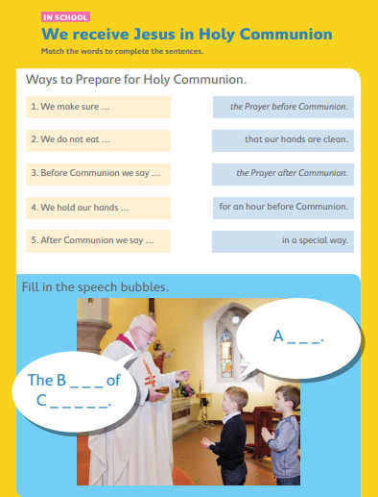
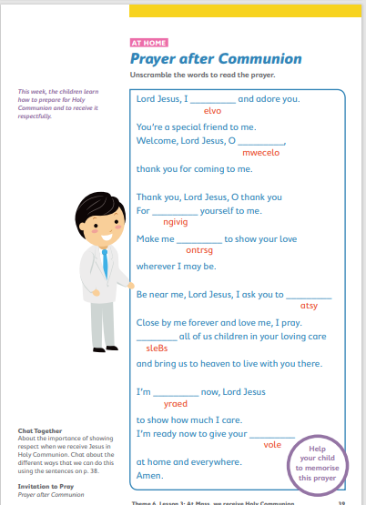

Slide 45
